Slide 1
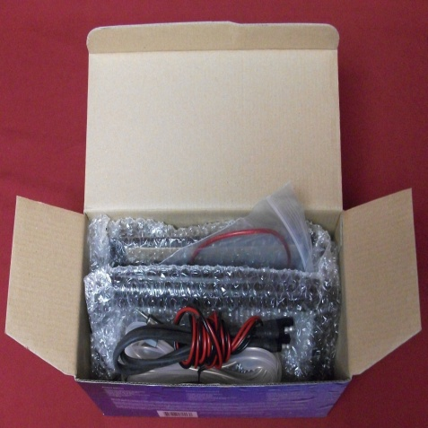
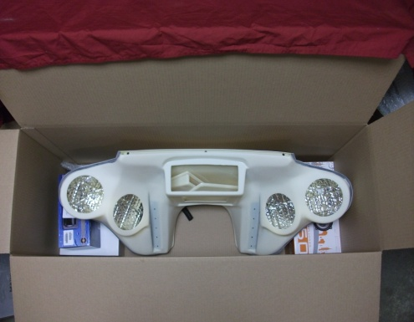
Wide Open Custom Plastic Packing List and Instructions Thank you for choosing Wide Open Custom
Tools Suggested:
Electric or Cordless Drill 11mm Wrench
Duct Tape Loctite Super Glue
Phillips Screw Driver Crimpers
Wire Cutters Electric Tape
Contents in Box:
ABS Plastic Fairing
1 Set of Brackets
1 Stereo
4 - Speakers (2 pair)
1 Windshield of your choose (5 ½”, 8”, 10”)
1 Stainless Windshield Trim
1 Windshield Rubber
2 - Access Panel– 1-Flat, 1-Cubby. Both need to be painted w/fairing (No Panels for Honda, Victory, Suzuki M109R, Mean Streak and V-Rods)
1 Stereo Housing Cover (4 screws in small package)
1 Wiring Harness
1 Antenna
Bolt Bag Contains (Located in BLACK Stereo Housing Box )
18 - 10 X ¾ Stainless Screws – Brackets
3 - ¼ X ¾ Stainless Bolts – Windshield Trim
3 - Washer/Nut combos – Windshield
3 - 5/16 x ¾ x 1/16 Neoprene Washer- Windshield trim
20 - 8 X ¾ Black Screws – Access Panel/Speaker Grill Replacements
2 - Battery Terminals – Wiring Harness
11 - Butt Connectors
1 – In Line fuse
1 - 15 Amp Fuse
EXTRA BOLTS WILL BE ADDED FOR:
Honda’s, Victory's, Kawasaki Nomad 1700, Yamaha Royal Star Tour Deluxe, and Raider, Harley Davidson V-Rod, Switchback, and Dyna family.
HINT: Install a couple of black screws in your brackets and pre-fit your fairing to your bike. You’ll find these in the black Stereo Housing box. Call the sales team if you have trouble or questions during your pre-fit. Do not open or install the stereo, speakers, or windshield until you have pre-fit your fairing. Make sure you paint the plastic wiring access panels if included with the fairing. NOTE: Paint the inside of Access Panels.
Bolt bag in here!
PRE-FIT FAIRING BEFORE PAINT!!
Paint Prep: Sand wet or dry using 400 grit(Wet is best). Seal with 2 part Epoxy Primer Sealer(PPG DP Epoxy Primer Sealer). (In Ben’s opinion this is the best, but any sealer will work.) Then top coat with any paint or gloss.
DO NOT PUT AN ADHESION PROMOTER ON THIS FAIRING WHEN PAINTING.

Slide 2
WIDE OPEN CUSTOM PLASTIC, LLC LIMITED WARRANTY & REPLACEMENT AGREEMENT
Shipping Damage:
Fairings are insured during shipping. Please notify us immediately of any shipping damage and we will work with our shipper to arrange for return and replacement of the damaged part as quickly as possible and at no charge to you.
One Year Limited Warranty:
All Wide Open Custom Plastic parts come with a one-year limited warranty on manufacturer defects from the date of purchase. Wide Open Custom Plastic warrants that every product meets our design and production specifications. For warranted repairs, the buyer is responsible for shipping charges to the manufacturer. If upon inspection, it is determined that there is a manufacturer defect, Wide Open Custom Plastic will cover all repairs or replacement of product if necessary. Customizations done after purchase are not covered by this warranty. For example, if there was a defect in an outer fairing shell which has been customized with paint and graphics, this warranty would cover replacement of the fairing shell but would not cover painting cost for a new fairing shell.
This warranty covers the replacement or repair of the product, at our sole discretions based on cost, availability, and the date of purchase. We may, upon our discretion, reimburse for repair cost (upon receipt of appropriate supporting documentation) or require the product be shipped to us for repair or replacement. This warranty covers use of the product under normal operating conditions, does not include any use of the product that falls outside of the designed and intended use and does not cover misuse, abuse or normal wear and tear of the product.
This warranty does not apply to any stereo receiver or speakers included with the fairing product. Such products are covered by the warranties as shown below.
30 Day Satisfaction Guarantee:
Products are only eligible for return within 30 days of delivery date for a refund of the purchase price paid, less shipping and handling, and will be subject to a 20% restock fees with a copy of the original invoice. The product must be undamaged and in new conditions and must be accompanied by a copy of the original sales receipt. The customer must contact us directly, before attempting to return the product. Products must be returned to us in their original or equivalent packing. The customer will be responsible for the cost of shipping the return product and for ensuring that it arrived undamaged. We recommend shipping insurance through the carrier utilized. Fairings that have been painted and/or modified during installation or for any other reason or damaged prior to or during shipping cannot be accepted for return. Please take particular care in handling windshields when packing them for return to avoid scratches.
The restocking fee is to cover inspection, to ensure the product was returned undamaged and in a sellable condition. We cannot accept returns of customer-painted pieces. Windshields cannot be exchanged or returned if the protective coating has been removed.
Stereo Equipment and Speakers:
Wide Open Custom Plastic does not manufacture stereo equipment or speakers. Warranties on any such products purchased through Wide Open Custom Plastic shall be limited to 6 months from the date of shipping. Upon returning or exchanging the stereo equipment and/or speakers, merchandise must be in original packaging. The stereo systems used are designed for automotive and marine use; therefore, the CD player will skip on occasion due to different suspension characteristics of the motorcycle, tires installed on the bike, the road conditions, a rubber-mounted motor on Road Kings, or the angle of the fairing installed on your bike.
This warranty sets forth Wide Open Custom’s entire warranty for its fairing products. Wide Open Custom makes no other warranty, expressed or implied, including no implied warranties of merchantability or fitness for a particular purpose, and in no instance will Wide Open Custom be responsible for indirect, consequential, or incidental damages allegedly caused by its fairing products. This is Wide Open Custom’s complete warranty, and may only be changed by Wide Open Custom’s written agreement.
The customers must contact the sales team to determine whether a product is in fact covered by the foregoing warranty before shipping it to us for repair or replacement. Contact us at 1-620-795-4421 (Mon. - Fri. 8:00 a.m.-5:00 p.m. CST)
SHIPPED: _____________________________________________

Slide 3
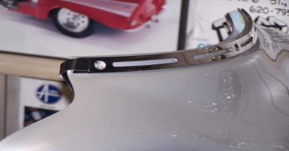
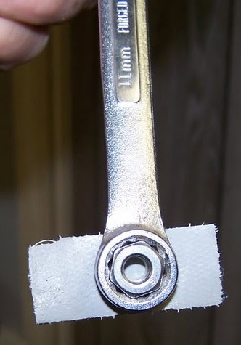
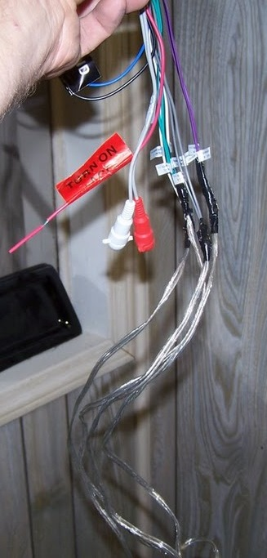
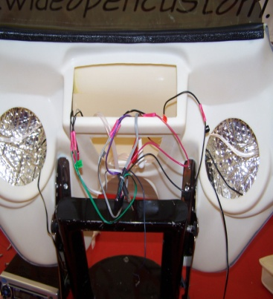
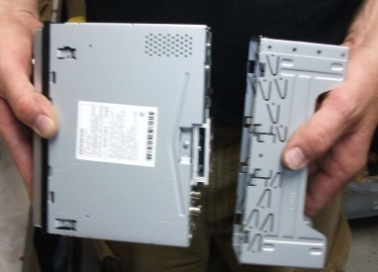
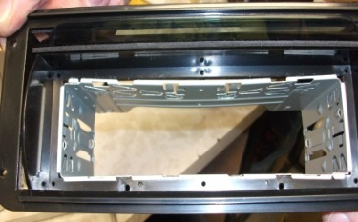
After Fairing is Painted Place the fairing in a soft chair or on a blanket to avoid scratching ,
Read and understand all steps in the instructions before starting the installation.
Install the mounting brackets using the 18 stainless steel screws. (See Picture1)
Install the stainless steel trim. Put the Neoprene Washer between the fairing and the trim. To make this process easier take a piece of Duct Tape and apply it on each side to hold the trim in place. (See Picture 2) Now install the windshield. Put a piece of duct tape on the back of the 11mm wrench, then put your washer/nut combo on it. This helps to hold it in place(It also makes it easier to bolt on the washer/nut combo.)( See Picture 3) Line the windshield up, start with the two outside holes and bolt those in. Then, pull the windshield back until the center hole lines s up with the center hole drilled on the fairing. May want to use some Loctite on the windshield bolts. Note: Do not over tighten bolts this might cause the windshield to crack.
Install the rubber trim between the windshield and the inside of the fairing. Start at both ends first and work your way to the middle. This helps protect from water. Note: Do not cut rubber trim. It should be tight!!!
Drape the antenna inside of the fairing and attach the ends with tape leaving the piece that connects to the stereo hanging out of the stereo opening. (This will not provide the range that a vertically mounted antenna will provide, but works fine in most cities.)
Take stereo wiring harness and wire your four speaker wires on with the butt connectors provided in the Bolt Kit. (See picture 4) Run speaker wire out of each speaker hole from inside of the fairing through the stereo opening. (See picture 5) Plug in speaker and attach to fairing with the black Phillips screws. . Note: It is best to pre-drill with small bit. (1/16” or smaller) Do not use the clips or speaker template. In the Bolt Bag are 16 Black Stainless steel screws that can be used to replace the screws given in the speaker boxes. These will not rust. Use them to mount the speaker grills. Feed short end of wiring harness through the bottom hole that is pre-drilled in the bottom of the fairing. Note: There will not be a pre-drilled hole in the bottom of the fairing if you purchased a M109 or Victory fairing. The hole can be drilled where ever you want the wire to come out. The displays are drilled on the bottom right hand side of the inner fairing. On some stereos it is just red to red and black to black. On others, it is red and yellow to red. (See wiring instructions of your stereo.)
Note: The stereo has a mounting sleeve. (See picture 6) Ensure that the mounting sleeve is installed correctly based on the illustration. (See picture 7&8) You have two options: 1. Slide the sleeve into the stereo housing unit. (See picture 7) Then slide the stereo into the sleeve and tape with the piece of double stick tape attached at the bottom back of the stereo housing. Take off the paper covering the tape, then stick your stereo to the splashguard cover. Tape around the housing unit and stereo with ¾” electrical or filament tape.(See picture 8 on back) Option 2. Put the metal sleeve on the stereo correctly. (See picture 6) Slide into the housing unit and tape with ¾” electrical or filament tape. Note: on some stereos the mounting sleeve is already placed correctly. On others, they need to be moved and positioned correctly.
1
2
3
4
5
6
6
7
If You Have Any Questions Please Contact WOC Sales Team At 620-795-4421
Or Email us at sales@wideopencustom.com

Slide 4
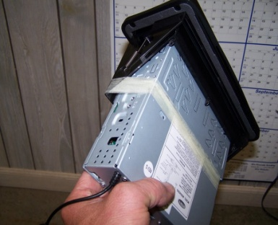
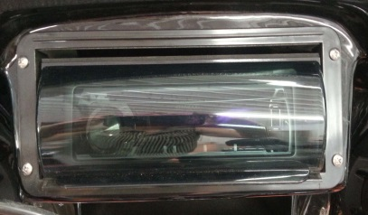
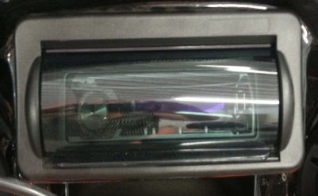
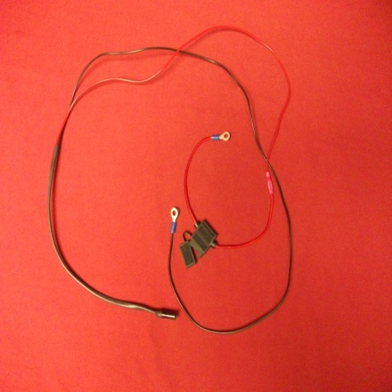
Install stereo into the fairing. Screw in with the four stainless steel screws that are in the stereo housing box.(See picture 9) After attaching the stereo, snap the trim ring on. Put the top on first, then pull the ring down and push the bottom in. It will snap securely into place. (See picture 10)
Remove the seat to gain access to the battery. Run the long part of the wiring harness under the fuel tank. Cut the in-line fuse wire (Red) down the middle and attach the in-line fuse to the red wire on the wiring harness, using the butt connector. (See picture 11) Connect the in-line fuse to the positive (red wire) and then connect the black wire to the negative on the battery with the two blue battery terminals. Note: Connecting these wires to constant power could result in draining the battery. Please un-plug wiring harness when not riding for a long period of time.
Secure any excess wiring out of the way and replace the seat.
Attach the wiring access panel with 4 black Phillip screws , 8x3/4. (In bolt bag)
Now follow the pre-fit instructions to mount on your bike.
8
9
d
10
11
If You Have Any Questions Please Contact WOC Sales Team At 620-795-4421
Or Email us at sales@wideopencustom.com

Slide 5
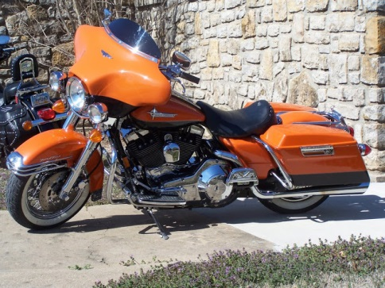
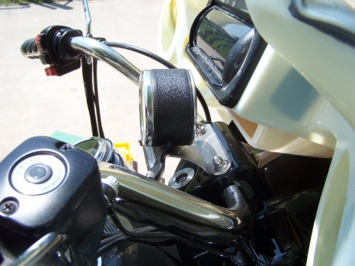
Pre-Fit Fairing Before Painting
Take everything out of the box to make sure that you have everything you will need. To Pre-fit the fairing, use
6 black 8 x ¾” screws (included for later use to attach the access panel) to attach the fairing to the brackets . Use one on each side along with one on the top and one on bottom.
Fairing Instructions for Road King
.
Prior to Pre-Fitting the fairing, move the running lights to the front hole.
When installing or removing the Roadking fairing, the fairing may hit the running lights, due to it sitting so close to the running lights. Suggestion: apply a sock or soft cloth to both running lights to prevent the fairing or running lights from being damaged. When installed, this fairing rests on the headlight.
The fairing fits on the factory quick disconnect windshield brackets. Check and make sure the black windshield grommets are not chewed up (If they are then they may need to be replaced). You may need to loosen the top bolts on your windshield mounts and spray water or Windex on your black windshield grommets just to make them wet. This enables the grommets to roll which helps to slide the top part of the brackets on. Once you have done this you are ready to pre-fit the fairing.
With the assistance of another person, line up the fairing brackets with the windshield brackets that are on the forks. Place the bottom of the fairing bracket onto the bottom bracket and rock the fairing onto the top windshield bracket. Don’t be afraid to manhandle it, the fairing can take it. Center the fairing on the bike to your desired location. When satisfied with the positioning, completely tighten your top bolts. (This is the only time you have to loosen or tighten your windshield brackets.)
Police Bike Editions: The Tach has to be relocated. The bracket will bring the Tach toward the driver.
Roadking Custom: The chrome wind deflectors on this bike may be left on or removed. If you leave it on, you wont be able to use the cubby hole that comes with the fairing. If it is removed you can then add the cubby hole if you choose.
Tips: When the fairing is close to headlight on one side loosen the screws and adjust the brackets by bending them slightly. (Example: If there is a larger gap on the left side, the right hand bracket should be adjusted. And vise versa.) To bend the brackets, you will need to wrap a rag around the brackets so they don’t get scuffed or scratched. Then, place the bracket’s short end into a vice and bend slightly. If it makes it worse then reloosen and push the other way. NOTE: Only do this if the fairing is NOT centered on the bike. If this does not solve the problem, you’ll have to take the top rubber grommets off and put on a washer for a spacer and put rubbers back on and re-install. This is just a suggestion on the washers. The brackets need to be at a 90 degree angle.
Roadking Standard
Tach Relocation Bracket
If You Have Any Questions Please Contact WOC Sales Team At 620-795-4421
Or Email us at sales@wideopencustom.com

Slide 6
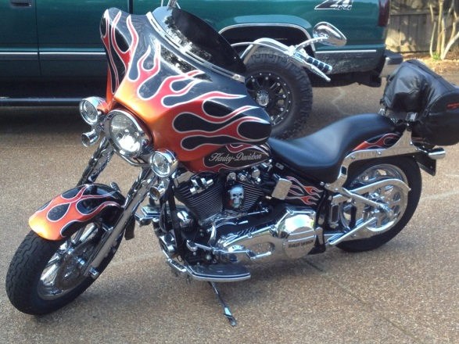
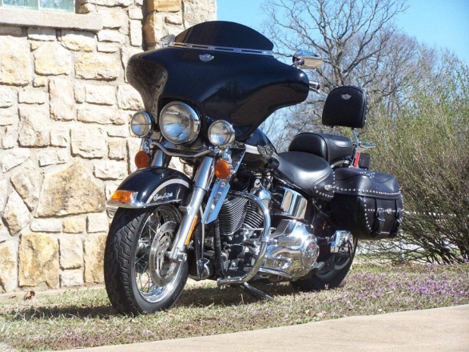
Pre-Fit Fairing Before Painting
Take everything out of the box to make sure that you have everything you will need. To Pre-fit the fairing, use 6 black 8 x ¾” screws (included for later use to attach the access panel) to attach the fairing to the brackets . Use one on each side along with one on the top and one on bottom.
Fairing Instructions for Softail/Fatboy
Fairing attaches to the factory quick disconnect. Must have the Heritage Softail Headlight (7in.) for the fairing to fit your bike.
Suggestion on Installation: Put your hand on the headlight and push it down until you hear it click. This takes the headlight out of play with installation of the fairing. This will not require you to loosen any bolts. This is the only time you will have to do this. Check and make sure your black windshield grommets are not chewed up or worn out (if they are then you may need to replace them.) You may need to loosen the top bolts on your windshield mounts and spray water or Windex to lubricate them. This will allow them to roll easier. This is the only time you will have to do this. Once you have done this you are ready to pre-fit the fairing.
With the assistance of another person, line up the fairing brackets with the windshield brackets that are on the bike’s fork tube. Place the bottom of the fairing bracket onto the bottom bracket and rock the fairing onto the top windshield bracket. Don’t be afraid to manhandle it, the fairing can take it. Once the fairing is on, tighten the top bolts of your windshield brackets and pull your headlight up.
Fatboy: may also need the 2” pullback risers. There are 2 different windshield brackets for the Fatboy, Wide and Narrow. Our fairing is made for the Wide windshield with light bar. Fatboy with the Narrow windshield brackets, without light bar, will need to add ¾” spacers and 1 ¾” bolt on the top bracket.
If You Have Any Questions Please Contact WOC Sales Team At 620-795-4421
Or Email us at sales@wideopencustom.com

Slide 7
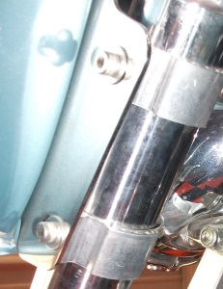
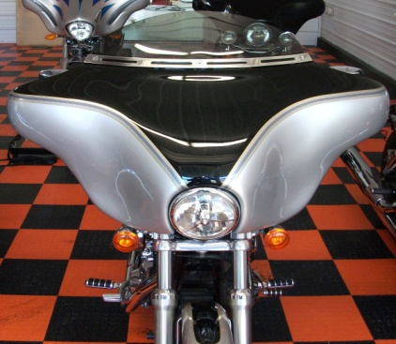
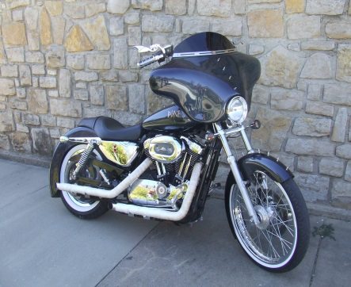
Pre-Fit Fairing Before Painting
Take everything out of the box to make sure that you have everything you will need. To Pre-fit the fairing, use 6 black 8 x ¾” screws (included for later use to attach the access panel) to attach the fairing to the brackets . Use one on each side along with one on the top and one on bottom.
Fairing Instructions for Sportster/Dyna Low Rider
All Dyna fairings, the headlight has to be mounted to the bottom triple tree.
-- 2006 models or newer already have the headlight mounted to the bottom triple tree. 2005 models and older have the headlight mounted on the top triple tree. Customer will need to re-locate or purchase a new headlight and mounting block to lower the headlight to the bottom triple tree.
Suggestions for Dyna Headlight and Bracket:
Part # 33-2141-VT Headlight assembly for 1996-1999 Harley FXSTS Springer Softail
Part # 31-0576-VT Bracket headlight Mount block for 1993-up
These part numbers were purchased from www.debrix.com. But could be purchased
at other businesses.
If the turn signals are located on the handlebars, relocation will be necessary.
Turn Signal Relocation Options: (if on handlebars)
Harley Davidson Turn Signal Relocation Kit Part #: H-D68517-94A
Turn Signal Relocation kit can be ordered from Wide Open Custom
($10/side) and Memphis Shades Adjustable Clamp ($25) Total $35
Sportster: Tachometer/Speedometer is on the handlebars. It must be re-located to
below handlebars. To make this work with the fairing.
Dyna fairings mount onto Memphis Shade Clamp brackets.
1. Attach the fork clamps to the fork tubes(Allen Head Screws should be on the outside of the forks).
Arrange the fork clamps as shown, but do not fully tighten yet - you should be able to move the
clamps around with some pressure.
2. Place the fairing on the bike, fully engaging the mounting brackets with the Allen head screw on
the fork clamps – start with the lower brackets. Once in place, slightly tighten the screw. Attach
the top brackets to the top fork clamps.
3. Adjust the alignment of the fairing by simply pushing it around and/or changing the position of
the fork clamps. Once it is in the correct location fully tighten the fork clamps and the screws.
Side View of Fork
Upper Tree
Memphis Shade Adjustable Clamps
Lower Tree
If You Have Any Questions Please Contact WOC Sales Team At 620-795-4421
Or Email us at sales@wideopencustom.com

Slide 8
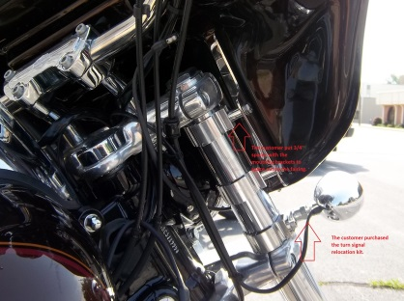
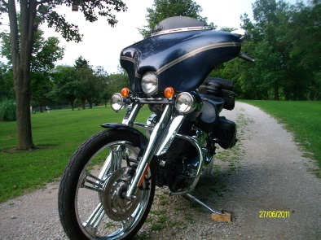
Pre-Fit Fairing Before Painting
Take everything out of the box to make sure that you have everything you will need. To Pre-fit the fairing, use 6 black 8 x ¾” screws (included for later use to attach the access panel) to attach the fairing to the brackets . Use one on each side along with one on the top and one on bottom.
Fairing Instructions for Dyna Wide Glide, Super Glide, Night Train, Softail Standard, Custom and Deuce
All Dyna fairings, the headlight has to be mounted to the bottom triple tree.
-- 2006 models or newer already have the headlight mounted to the bottom triple tree. 2005 models and older have the headlight mounted on the top triple tree. Customer will need to purchase a new headlight and mounting block system.
Suggestions for Dyna Headlight and Bracket: www.debrix.com
Part # 33-2141-VT Headlight assembly for 1996-1999 Harley FXSTS Springer Softail
Part # 31-0576-VT Bracket headlight Mount block for 1993-up
If the turn signals are located on the handlebars, relocation will be necessary.
Turn Signal Relocation Options: (if on handlebars)
Harley Davidson Turn Signal Relocation Kit Part #: H-D68517-94A ($60)
Turn Signal Relocation kit can be ordered from Wide Open Custom
($10/side) and Memphis Shades Adjustable Clamp ($25) Total: $35.00
Super Glide: May require pull back risers for the handlebars and turn signal
relocation kit. Uses 4- ½” spacers and 4- 1 ½” bolts.
Night Train, Softail Standard, Custom and Deuce: Uses 4- ¼” washers to space out
to the fairing.
Dyna fairings mount onto Memphis Shade Clamp brackets.
1. Attach the fork clamps to the forks (Allen head screws should be on the outside of the forks).
Arrange the forks as shown, but do not fully tighten yet - you should be able to move the
clamps around with some pressure. Loosen the Allen head screws.
2. Place the fairing on the bike, fully engaging the mounting brackets with the Allen head screw on
the fork clamps – start with the lower brackets. Once in place, slightly tighten the screw. Attach the top brackets to the top fork clamps.
3. Adjust the alignment of the fairing by simply pushing it around and/or changing the position of
the fork clamps. Once it is in the correct location fully tighten the fork clamps and the screws.
Side View of Fork
Upper Tree
Memphis Shade Adjustable Clamps
Lower Tree
Dyna Wide Glide
Super Glide Pull Back riser, Turn Signal relocater, and spacers
Softail Deuce
If You Have Any Questions Please Contact WOC Sales Team At 620-795-4421
Or Email us at sales@wideopencustom.com

Slide 9
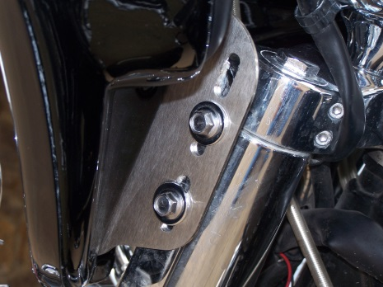
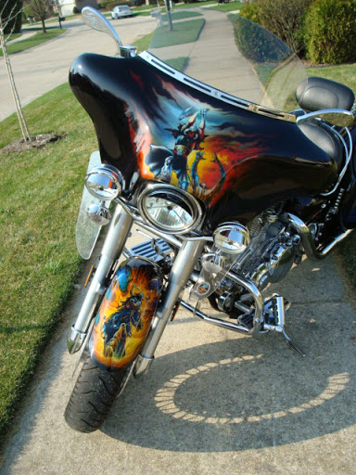
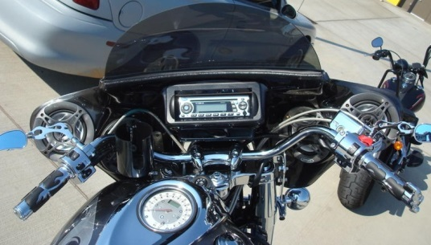
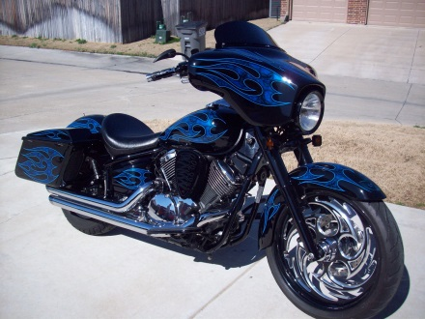
Pre-Fit Fairing Before Painting
Take everything out of the box to make sure that you have everything you will need. To Pre-fit the fairing, use 6 black 8 x ¾” screws (included for later use to attach the access panel) to attach the fairing to the brackets . Use one on each side along with one on the top and one on bottom.
Fairing Instructions for Yamaha Roadstar
Yamaha Roadstar fairing bolts on to the factory windshield bracket.
Note: If the factory windshield bracket is not previously installed on the bike, it can be purchased at a Yamaha dealership. Part #: STR-4WM03-40-00
Yamaha Roadstar Models include: Midnight, Silverado, Midnight Silverado, Silver Edition, and Silverado Silver Edition.
The Yamaha Roadstar is a bolt-on style fairing in the same manner as the
factory windshield. The fairing is not quick detach and does not lock onto the motorcycle’s fork tubes. (see picture)
If You Have Any Questions Please Contact WOC Sales Team At 620-795-4421
Or Email us at sales@wideopencustom.com

Slide 10
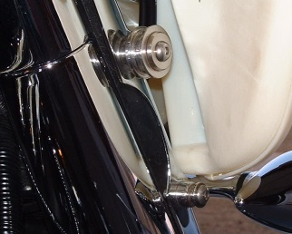
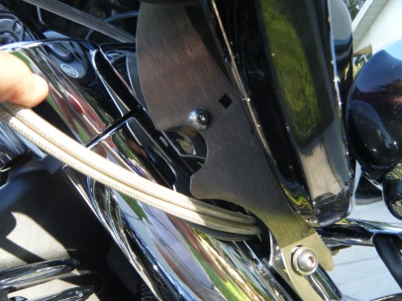
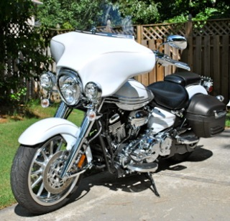
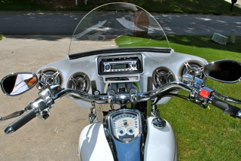
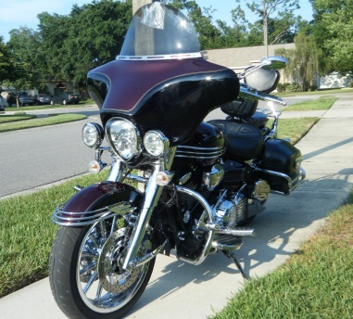
Pre-Fit Fairing Before Painting
Take everything out of the box to make sure that you have everything you will need. To Pre-fit the fairing, use 6 black 8 x ¾” screws (included for later use to attach the access panel) to attach the fairing to the brackets . Use one on each side along with one on the top and one on bottom.
Fairing Instructions for Yamaha Stratoliner/Roadliner:
The Yamaha Stratoliner/Roadliner fairing mounts to the factory quick release windshield bracket. Some Roadliner motorcycles do not come with a factory windshield already installed. If this is the case, the customer may purchase the same factory bracket as the one purchased for the Stratoliner. Part #: STR-2C503-40-00 The fairing will go on in the same manner as the factory windshield.
A lock-kit can be used with the fairing mounting brackets, that are sent with the fairing. This lock-kit can be purchased at a Yamaha dealership. Part #: STR-2C590-10-00
With the assistance of another person, line up the fairing brackets with the windshield brackets that are on the bike’s fork tube. Place the bottom of the fairing bracket onto the bottom bracket and rock the fairing onto the top windshield bracket. Don’t be afraid to manhandle it, the fairing can take it.
For help on installation visit www.youtube.com
In the search bar type: “ WOC Fairing w/ Stratoliner Quick Mounts”
Note: Some customers have taken a dermal tool to modify the bracket, allowing the fairing to lay back more.
If You Have Any Questions Please Contact WOC Sales Team At 620-795-4421
Or Email us at sales@wideopencustom.com

Slide 11
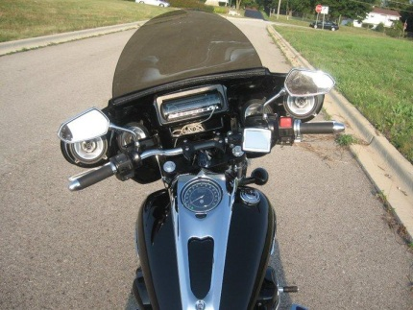
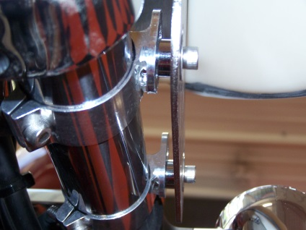
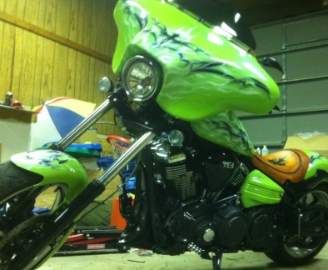
Pre-Fit Fairing Before Painting
Take everything out of the box to make sure that you have everything you will need. To Pre-fit the fairing, use 6 black 8 x ¾” screws (included for later use to attach the access panel) to attach the fairing to the brackets . Use one on each side along with one on the top and one on bottom.
Fairing Instructions for Yamaha Raider
The Yamaha Raider is a bolt-on style fairing. The fairing is not quick detach and does not lock onto the motorcycle’s fork tubes. Yamaha Raider fairings only mount up to the Memphis Shades adjustable clamp bracket.
Yamaha Raider fairings mount onto Memphis Shade Clamp brackets.
Yamaha Raider Fork Tube size: 46mm (1.8” in diameter)
Memphis Shades Part #: MEM9955
Installing Memphis Shades Adjustable Clamp bracket:
1. Attach the fork clamps to the forks (Allen head screws should be on the outside of the forks). Arrange the forks as shown, but do not fully tighten yet - you should be able to move the clamps around with some pressure. Loosen the Allen head screws.
2. Place the fairing on the bike, fully engaging the mounting brackets with the Allen head screw on the fork clamps – start with the lower brackets. Once in place, slightly tighten
the screw. Attach the top brackets to the top fork clamps.
3. Adjust the alignment of the fairing by simply pushing it around and/or changing the position of the fork clamps. Once it is in the correct location fully tighten the fork clamps and the screws.
Side view of the Fork
Upper Tree
Memphis Shade Adjustable Clamps
Lower Tree
If You Have Any Questions Please Contact WOC Sales Team At 620-795-4421
Or Email us at sales@wideopencustom.com

Slide 12
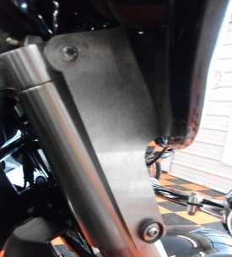
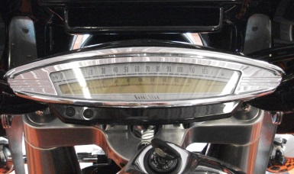
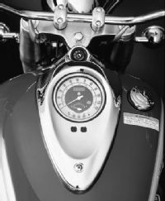
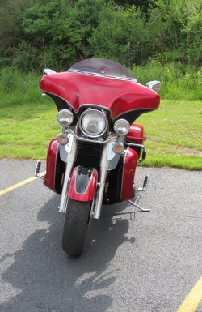
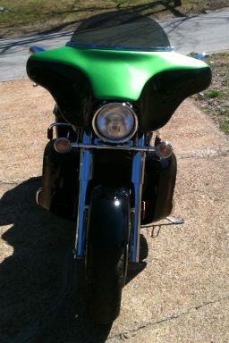
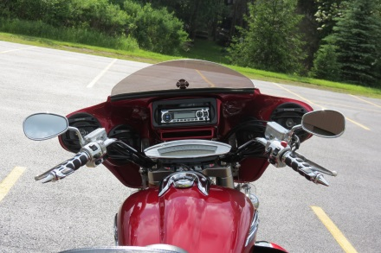
Pre-Fit Fairing Before Painting
Take everything out of the box to make sure that you have everything you will need. To Pre-fit the fairing, use 6 black 8 x ¾” screws (included for later use to attach the access panel) to attach the fairing to the brackets . Use one on each side along with one on the top and one on bottom.
Fairing Instructions for Yamaha Royal Star Tour Deluxe
The Yamaha Royal Star Tour Deluxe has 2 different factory windshield brackets. See descriptions below.
2005 and Newer: (Retro Speedometer on Handlebars)
Bolts onto factory windshield brackets.
The top 2 spinners or grommets need to be taken off and use bolts and washer, given in the bolt bag.
The bottom of the windshield bracket sits in the spinner or grommet. (See picture below)
2004 and Older: (Speedometer mounted on tank)
Bolts on with the four factory windshield brackets.
Retro Speedometer
WOC Fairing Brackets Mount
Speedometer on Tank
WOC Fairing Bracket Mount
If You Have Any Questions Please Contact WOC Sales Team At 620-795-4421
Or Email us at sales@wideopencustom.com

Slide 13
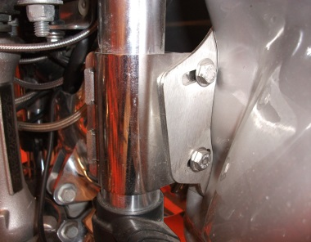
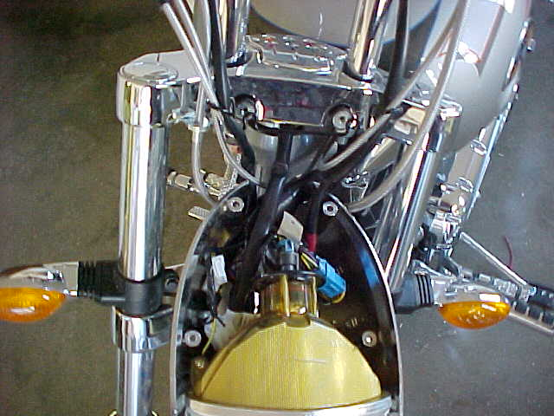
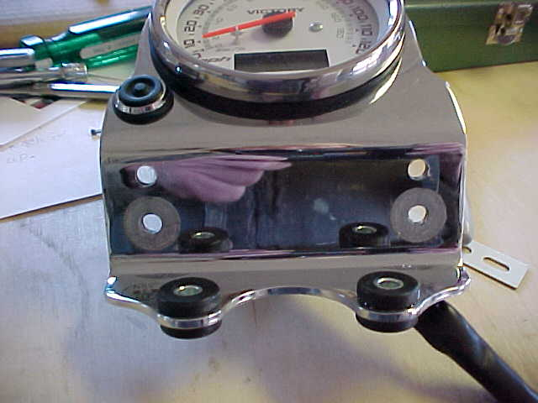
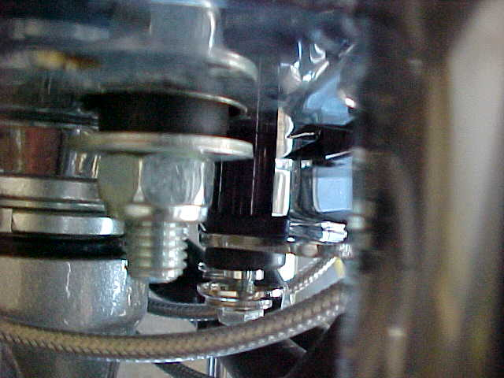
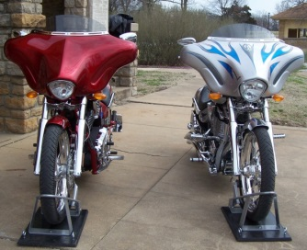
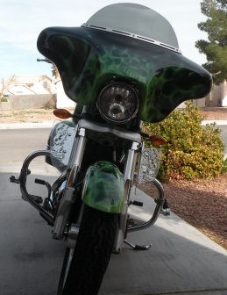
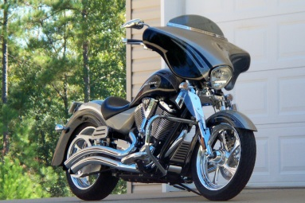
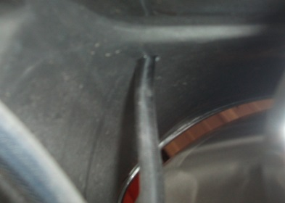
Pre-Fit Fairing Before Painting
Take everything out of the box to make sure that you have everything you will need. To Pre-Fit the fairing, use 6 black 8 x ¾” screws to attach the fairing to the brackets . Use one on each side along with one on the top and one on bottom.
Fairing Instructions for Victory
Victory Fairing mounts onto the factory clamp windshield bracket. Using the two 5/16” bolts given, attach the fairing to the factory clamp bracket (See picture 1).
Victory motorcycles come with two headlight options, round or bullet (diamond). WOC offers two fairing options for the bikes with the bullet headlight style; diamond smooth or diamond ridge. (see pictures below)
Victory Part Numbers for Factory Clamp Windshield Brackets:
Part # 2874426 - 43mm Forks Ex: Vegas Jackpot, Hammer, and Kingpin
Part # 2874679 - 55mm Forks Inverted Ex: Kingpin and Hammer
Part # 2201712 - 45 mm Forks Ex: V-92
1
2
Suggestions for Lowering the Speedometer:
Lowering the speedometer ¾” will help lay the fairing back for a more sporty look.
Take the 4 screws out of the top of the headlight. (see picture 2).
Unplug the speedometer.
Loosen the 4 bolts on the speedometer and remove.
Measure ¾” up from the top holes and drill (See picture 3).
Get ¾” plastic spacers and ¾” longer bolt from your local hardware store.
Reinstall the speedometer in the new holes using the ¾” plastic spacers and longer bolt on the bottom (See picture 4).
3
4
Add ¾” plastic spacer
Wiring harness
Victory Diamond Ridge
Victory Round
Victory Diamond Smooth
5
Note: There will not be a pre-drilled hole in the bottom of the Victory fairing. The hole can be drilled where ever you want the wire to come out. We drilled on the bottom right hand side of the inner fairing (See picture 5).

Slide 14
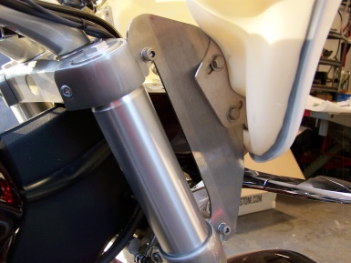
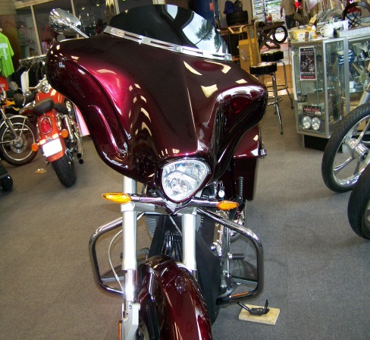
Pre-Fit Fairing Before Painting
Take everything out of the box to make sure that you have everything you will need. To Pre-Fit the fairing, use 6 black 8 x ¾” screws to attach the fairing to the brackets . Use one on each side along with one on the top and one on bottom.
Fairing Instructions for Victory Cross Roads
Victory Fairing mounts to the 4 Allen-head bolts coming from the side of the forks. Using the two 5/16” bolts given, attach the two brackets together (See picture 1).
WOC offers two fairing options for the bikes with the bullet headlight style; Diamond Smooth or Diamond Ridge.
1
Suggestions for Lowering the Speedometer:
Lowering the speedometer ¾” will help lay the fairing back for a more sporty look.
Take the 4 screws out of the top of the headlight. (see picture 2).
Unplug the speedometer.
Loosen the 4 bolts on the speedometer and remove.
Measure ¾” up from the top holes and drill (See picture 3).
Get ¾” plastic spacers and ¾” longer bolt from your local hardware store.
Reinstall the speedometer in the new holes using the ¾” plastic spacers and longer bolt on the bottom (See picture 4).
2
3
4
Add ¾” plastic spacer
Wiring harness
Cross Roads
Note: There will not be a pre-drilled hole in the bottom of the Victory fairing. The hole can be drilled where ever you want the wire to come out. We drilled on the bottom right hand side of the inner fairing (See picture 5).
5

Slide 15
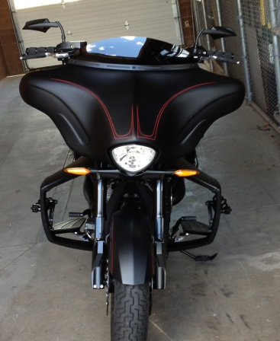
Pre-Fit Fairing Before Painting
Take everything out of the box to make sure that you have everything you will need. To Pre-Fit the fairing, use 6 black 8 x ¾” screws to attach the fairing to the brackets . Use one on each side along with one on the top and one on bottom.
Fairing Instructions for Victory Hard Ball
Victory Fairing mounts to the 4 Allen-head bolts coming from the side of the forks. Using the two 5/16” bolts given, attach the two brackets together (See picture 1).
WOC offers two fairing options for the bikes with the bullet headlight style; Diamond Smooth or Diamond Ridge.
1
Suggestions for Lowering the Speedometer:
Lowering the speedometer ¾” will help lay the fairing back for a more sporty look.
Take the 2 screws and replace them with stainless steel M6-1.00x40 bolt. Change out the spacer for smaller spacer between the speedo and mounting bracket.
Note: There will not be a pre-drilled hole in the bottom of the Victory fairing. The hole can be drilled where ever you want the wire to come out. We drilled on the bottom right hand side of the inner fairing (See picture 2).
Wiring harness
2
Hard-Ball
Driver’s View

Slide 16
Pre-Fit Fairing Before Painting
Take everything out of the box to make sure that you have everything you will need. To Pre-Fit the fairing, use 6 black 8 x ¾” screws to attach the fairing to the brackets . Use one on each side along with one on the top and one on bottom.
Fairing Instructions for Victory V-92
Victory V-92 may come with or without factory windshield brackets.
Mounting bracket systems will change depending on whether or not
the bike has a light bar. WOC now has brackets for both types.
V-92 without factory windshield bracket will need to purchase the factory clamp bracket. Victory Part # 2201712- 45mm forks
(see picture 1)
The V-92 with the factory windshield brackets, are located on the
side of the forks.
Suggestion for using the existing factory windshield bracket:
On the factory bracket, the customer may need to drill two holes (5/16”)to allow the mounting bracket a place to bolt. This allows for adjustment in the fairing around the headlights and running lights. (see picture 2)
Using the four 1” bolts provided in the bolt bag, attach the fairing mounting bracket to the factory windshield bracket. Tighten on the backside by using the washer and nut also provided.
WOC’s Victory V-92 fairing allows the motorcycle’s speedo to
remain visible. (see picture 3)
Note: The fairing will fit very tight around the headlight.
Picture 1
Picture 2
Picture 3
Without Light bar
With Light bar
If You Have Any Questions Please Contact WOC Sales Team At 620-795-4421
Or Email us at sales@wideopencustom.com

Slide 17
Pre-Fit Fairing Before Paint
Take everything out of the box to make sure that you have everything you will need. To Pre-fit the fairing, use 6 black 8 x ¾” screws to attach the fairing to the brackets . Use one on each side along with one on the top and one on bottom.
Suzuki M109R
1
THIS FAIRING IS A VERY TIGHT FIT. It may take 2 people to put the fairing on the bike. Park the motorcycle on a hard, level surface and turn off the ignition
Install the of Memphis Shade brackets approx. 1 ¼” from the top of the triple tree. The 2nd set of Memphis Shade brackets are approx. 1” from the bottom triple tree.
Due to the fairing being a tight fit around the headlight.(Picture 1) Put duct tape on the headlight cow (Picture 2) to avoid any scratches to the headlight cow or painted fairing. ( Duct tape can be removed after install.)
Notice how close the fairing sits to the Tach (Picture 3)
Note: There will not be a pre-drilled hole in the bottom of the M109R fairing. The hole can be drilled where ever you want the wire to come out. We drilled on the bottom right hand side of the inner fairing close to the headlight.
Pictures below show how our fairing attaches to the Memphis Shade brackets.
1 ¼” in 1”in
2
3
If You Have Any Questions Please Contact WOC Sales Team At 620-795-4421
Or Email us at sales@wideopencustom.com

Slide 18
Pre-Fit Fairing Before Paint
Take everything out of the box to make sure that you have everything you will need. To Pre-fit the fairing, use 6 black 8 x ¾” screws to attach the fairing to the brackets . Use one on each side along with one on the top and one on bottom.
Suzuki M90 & M50
1
THIS FAIRING IS A VERY TIGHT FIT. It may take 2 people to put the fairing on the bike. Park the motorcycle on a hard, level surface and turn off the ignition
Install the of Memphis Shade brackets approx. 1 ¼” from the top of the triple tree. The 2nd set of Memphis Shade brackets are approx. 1” from the bottom triple tree.
Due to the fairing being a tight fit around the headlight.(Picture 1) Put duct tape on the headlight cow (Picture 2) to avoid any scratches to the headlight cow or painted fairing. ( Duct tape can be removed after install.)
Notice how close the fairing sits to the Tach (Picture 3)
Note: There will not be a pre-drilled hole in the bottom of the M90 & M50 fairing. The hole can be drilled where ever you want the wire to come out. We drilled on the bottom right hand side of the inner fairing close to the headlight.
Pictures below show how our fairing attaches to the Memphis Shade brackets. Top Clamp: MEM 9955 42-50 mm
1 ¼” in 1”in Bottom Clamp: MEM 995448-55 mm
2
3
If You Have Any Questions Please Contact WOC Sales Team At 620-795-4421
Or Email us at sales@wideopencustom.com

Slide 19
Pre-Fit Fairing Before Paint
Take everything out of the box to make sure that you have everything you will need. To Pre-fit the fairing, use 6 black 8 x ¾” screws (included for later use to attach the access panel) to attach the fairing to the brackets . Use one on each side along with one on the top and one on bottom.
Fairing Instructions for Suzuki C50, C90, C109R, Intruder 1500 LC
The Suzuki is a bolt-on style fairing in the same manner as the factory windshield. The fairing is not a quick detach as seen in the picture to the right.
Suzuki C-50 fairing bolts onto the factory windshield bracket.
Note: If the factory windshield bracket is not previously installed on the bike, it can be purchased at Suzuki dealership Part #: 990A0-70022-006.
Suzuki C-90 & C-109R: Fairing bolts onto the factory windshields bracket.
Note: If the factory windshield bracket is not previously installed on the bike, it can be purchased at Suzuki dealership Part #:990A0-70015.
Suzuki 1500 Intruder LC bolts onto the factory windshield brackets on the side of the forks. You may need to add a spacer depending on the windshield bracket.
C50
C90
Intruder 1500 LC
If You Have Any Questions Please Contact WOC Sales Team At 620-795-4421
Or Email us at sales@wideopencustom.com

Slide 20
Pre-Fit Fairing Before Painting
Take everything out of the box to make sure that you have everything you will need. To Pre-fit the fairing, use 6 black 8 x ¾” screws (included for later use to attach the access panel) to attach the fairing to the brackets . Use one on each side along with one on the top and one on bottom.
Fairing Instructions for Kawasaki
Nomad 1500,1600, 1700, Vulcan 900, and VN2000 Classic
.
Vulcan 900: Fairing bolts onto the factory windshield brackets. Will not work with Memphis Shade windshield brackets. If you have a light bar see the attached sheets for modifications that will need to be done to the light bar. We have part numbers for the factory windshield brackets upon request.
Nomad 1600 & 1700: Fairing bolts on the Nomad factory windshield brackets. Will not work with the Memphis Shade Brackets.
Nomad 1500: Fairing bolts on the factory windshield brackets that are mounted on the side of the fork tubes. You may need a spacer this will space out the fairing to make it fit properly. If you need a spacer you may purchase the spacers at your local hardware store. Windshields mounts center – center 5 inches. There is a 2 ½” center to center w/s bracket they can drill on the bracket to use ours.
VN2000 Classic fairing bolts on the factory windshield brackets. Windshield brackets Part #11054-0576 (06 VN2000)
Fairing will not go on a VN2000 with a Big Nacelle headlight. (Large headlight with 3 small lights within the headlight)
Nomad Fairing
VN2000 Inner Fairing
If You Have Any Questions Please Contact WOC Sales Team At 620-795-4421
Or Email us at sales@wideopencustom.com

Slide 21
Pre-Fit Fairing Before Painting
Take everything out of the box to make sure that you have everything you will need. To Pre-fit the fairing, use 6 black 8 x ¾” screws to attach the fairing to the brackets . Use one on each side along with one on the top and one on bottom.
Fairing Instructions for V-Rod
This V-Rod Fairing is Very Tight around the headlight. You can change out the headlight if you choose as seen in picture below.
If the turn signals are located on the handlebars, relocation will be necessary.
Turn Signal Relocation Options: (if on handlebars)
Harley Davidson Turn Signal Relocation Kit Part #: H-D68517-94A
Turn Signal Relocation kit can be ordered from Wide Open Custom
($10/side) and Memphis Shades Adjustable Clamp ($25) Total $35
Dyna fairings mount onto Memphis Shade Clamp brackets.
1. Attach the fork clamps to the fork tubes(Allen Head Screws should be on the outside of the forks).
Arrange the fork clamps as shown, but do not fully tighten yet - you should be able to move the clamps around with some pressure.
2. Place the fairing on the bike, fully engaging the mounting brackets with the Allen head screw on the fork clamps – start with the lower brackets. Once in place, slightly tighten the screw. Attach
the top brackets to the top fork clamps.
3. Adjust the alignment of the fairing by simply pushing it around and/or changing the position of the fork clamps. Once it is in the correct location fully tighten the fork clamps and the screws.
V-Rod w/Freedom Wings
V-Rod Muscle Changed headlight.
You Have Any Questions Please Contact WOC Sales Team At 620-795-4421
Or Email us at sales@wideopencustom.com

Slide 22
Pre-Fit Fairing Before Painting
Take everything out of the box to make sure that you have everything you will need. To Pre-fit the fairing, use 6 black 8 x ¾” screws (included for later use to attach the access panel) to attach the fairing to the brackets . Use one on each side along with one on the top and one on bottom.
Fairing Instructions for Triumph Rocket 3 Touring
Bolts onto the factory w/s brackets. The top 2 spinners or grommets take off and use bolts and washer the bottom set on a “C” or “U”
If You Have Any Questions Please Contact WOC Sales Team At 620-795-4421
Or Email us at sales@wideopencustom.com

Slide 23
Pre-Fit Fairing Before Painting
Fairing Instructions for Honda VTX 1300 and 1800
Honda Fairing attaches to VTX 1300R & 1300S with No modifications or drilling.
Even though the package on the brackets say for VTX 1300, they fit VTX 1800’s as well.
On all other Honda VTX models 1300 & all 1800 (R,C,N,S) you MUST drill ¼” hole in the bottom triple tree on these models. See website under Installation instructions to see more pictures of installation of Memphis Shades. Please use 2or 3 washers under the brackets for shims or you may shim from the top. This will help get the fairing closer to your headlight. This is your preference.
1- Take everything out of the box to make sure that you have everything you will need.
2- Next, attach top two bolts of bracket to the top triple tree. (To Shim see above)
3- With bottom of brackets hanging loose, attach fairing to brackets and center fairing on bike. While holding fairing in this position, mark where you will need to drill into bottom triple tree for bottom of bracket. (To Shim see above.)
4- Remove headlight (2 bolts) and lay a rag between hanging headlight and fender to avoid scratching. Also remove brackets from triple tree.
5- Drill two holes, ¼” each on both sides of bottom of triple tree.
6- Put bracket back on and reinstall headlight.
Looking down on the bottom triple tree with the bracket installed. With a ¼” hole drilled for the 2nd bracket installation.
Brackets installed with headlight out.
Looking down on the bottom of the triple tree where the ¼” hole has been drilled and the bracket is installed.
Side view of brackets installed and headlight off.
Side view of installed brackets and headlight reattached.
Looking down on the fairing with the Memphis Shade bracket installed.
If You Have Any Questions Please Contact WOC Sales Team At 620-795-4421
Or Email us at sales@wideopencustom.com

Slide 24
Pre-Fit Fairing Before Painting
Fairing Instructions for Honda VTX 1300 and 1800
Honda VTX 1300 R/S Fairing attaches with No modifications or drilling.
Even though the package on the brackets say for VTX 1300, they fit VTX 1800’s as well.
On all other Honda VTX models 1300 & all 1800 (R,C,N,S) you MUST drill ¼” hole in the bottom triple tree on these models. See website under Installation instructions to see more pictures of installation of Memphis Shades. Please use 2or 3 washers under the brackets for shims or you may shim from the top. This will help get the fairing closer to your headlight. This is your preference.
1- Take everything out of the box to make sure that you have everything you will need.
2- Next, attach top two bolts of bracket to the top triple tree. (To Shim see above)
3- With bottom of brackets hanging loose, attach fairing to brackets and center fairing on bike. While holding fairing in this position, mark where you will need to drill into bottom triple tree for bottom of bracket. (To Shim see above.)
4- Remove headlight (2 bolts) and lay a rag between hanging headlight and fender to avoid scratching. Also remove brackets from triple tree.
5- Drill two holes, ¼” each on both sides of bottom of triple tree.
6- Put bracket back on and reinstall headlight.
Looking down on the bottom triple tree with the bracket installed. With a ¼” hole drilled for the 2nd bracket installation.
Brackets installed with headlight out.
Looking down on the bottom of the triple tree where the ¼” hole has been drilled and the bracket is installed.
Side view of brackets installed and headlight off.
Side view of installed brackets and headlight reattached.
Looking down on the fairing with the Memphis Shade bracket installed.
If You Have Any Questions Please Contact WOC Sales Team At 620-795-4421
Or Email us at sales@wideopencustom.com

Slide 25
Pre-Fit Fairing Before Painting
Take everything out of the box to make sure that you have everything you will need. To Pre-fit the fairing, use 6 black 8 x ¾” screws to attach the fairing to the brackets . Use one on each side along with one on the top and one on bottom.
Fairing Instructions for Honda Valkyrie
The Honda Valkyrie fairing is a bolt-on style fairing. The fairing is not quick detach and does not lock onto the motorcycle fork tubes. The fairing only mounts up to the Memphis Shades adjustable clamp brackets.
Valkyrie fairing’s will work with the stock gages and running lights. There is no adjustment needed to be made.
Honda Valkyrie fairings mount onto Memphis Shade Clamp brackets.
Memphis Shades Part #: MEM9954
Installing Memphis Shade Adjustable Clamp bracket:
1. Attach the fork clamps to the forks (Allen head screws should be on the outside of the forks). Arrange the forks as shown, but do not fully tighten yet - you should be able to move the clamps around with some pressure. Loosen the Allen head screws.
2. Place the fairing on the bike, fully engaging the mounting brackets with the ¼” Chrome spacer and Allen head screw on the fork clamps – start with the lower brackets. Once in place, slightly tighten the screw. Attach the top brackets to the top fork clamps (See picture above).
3. Adjust the alignment of the fairing by simply pushing it around and/or changing the position of the fork clamps. Once it is in the correct location fully tighten the fork clamps and the screws.
Memphis Shade Brackets with ¼” Chrome Spacer.
Driver’s View
Honda Valkyrie
If You Have Any Questions Please Contact WOC Sales Team At 620-795-4421
Or Email us at sales@wideopencustom.com

Slide 26
Pre-Fit Fairing Before Painting
Take everything out of the box to make sure that you have everything you will need. To Pre-fit the fairing, use 6 black 8 x ¾” screws to attach the fairing to the brackets . Use one on each side along with one on the top and one on bottom.
Fairing Instructions for Honda Rune
WOC offers two fairing options for the bikes with the bullet headlight style; diamond smooth or diamond ridge. (see pictures below)
Honda Rune fairings mount onto Memphis Shade Clamp brackets.
Memphis Shades Part #: MEM 9954
Installing Memphis Shade Adjustable Clamp bracket:
1. Attach the fork clamps to the forks (Allen head screws should be on the outside of the forks). Arrange the forks as shown, but do not fully tighten yet - you should be able to move the clamps around with some pressure. Loosen the Allen head screws. (see picture 1)
2. Place the fairing on the bike, fully engaging the mounting brackets with the Allen head screw on the fork clamps – start with the lower brackets. Once in place, slightly tighten the screw. Attach the top brackets to the top fork clamps.
3. Adjust the alignment of the fairing by simply pushing it around and/or changing the position of the fork clamps. Once it is in the correct location fully tighten the fork clamps and the screws.
4- 1” Chrome spacers, 4-M6 x 40 bolts (1 ¾”), 4-Meteric Nuts attach the Honda Rune bracket and Honda Rune Extension brackets. Honda Rune brackets and the Honda Rune Extension brackets attach to the fairing by using the 18 Stainless Steel screws provided in the bolt bag (see picture 2).
Turn signals must be lowered to clear the fairing.
1
2
Diamond Ridge
Diamond Smooth
If You Have Any Questions Please Contact WOC Sales Team At 620-795-4421
Or Email us at sales@wideopencustom.com

Slide 27
Pre-Fit Fairing Before Painting
Take everything out of the box to make sure that you have everything you will need. To Pre-fit the fairing, use 6 black 8 x ¾” screws (included for later use to attach the access panel) to attach the fairing to the brackets . Use one on each side along with one on the top and one on bottom.
Fairing Instructions for Kawasaki Mean Streak
The Kawasaki Mean Streak is a bolt-on style fairing. The fairing is not quick detach and does not lock onto the motorcycle’s fork tubes. Kawasaki Mean Streak fairings only mount up to the Memphis Shades adjustable clamp bracket.
Kawasaki Mean Streak fairings mount onto Memphis Shade Clamp brackets.
Kawasaki Mean Streak Fork Tube size: 46mm Memphis Shades Part #: MEM 9955 (42-50mm). Inverted Fork Tubes use Memphis Shade Part # MEM 9954 (48-55mm).
Installing Memphis Shades Adjustable Clamp bracket:
1. Attach the fork clamps to the forks (Allen head screws should be on the outside of the forks). Arrange the forks as shown, but do not fully tighten yet - you should be able to move the clamps around with some pressure. Loosen the Allen head screws.
2. Place the fairing on the bike, fully engaging the mounting brackets with the Allen head screw on the fork clamps – start with the lower brackets. Once in place, slightly tighten
the screw. Attach the top brackets to the top fork clamps.
3. Adjust the alignment of the fairing by simply pushing it around and/or changing the position of the fork clamps. Once it is in the correct location fully tighten the fork clamps and the screws.
Side view of the Fork
Upper Tree
Memphis Shade Adjustable Clamps
Lower Tree
If You Have Any Questions Please Contact WOC Sales Team At 620-795-4421
Or Email us at sales@wideopencustom.com

